Slide 1

EduGamers: Transforming Education
Welcome to EduGamers, where learning becomes an exciting adventure

Slide 2

The Problem
1
Uninspired Learning
2
Lack of Engagement
Traditional education feels boring.
Games lack educational value.
3
Need for Solutions
Parents and educational organization struggle.

Slide 3
The Solution
Interactive Learning
Exciting Challenges
Rewards and Motivation
Turns school curricula into games.
Introduces educational competitions.
Provides daily challenges with prizes.

Slide 4

Value Proposition
Fun Learning
Skill Development
Interactive and engaging experience.
Critical thinking, problem-solving, and teamwork.
Motivated Learners
Modern Education
Challenges, competitions, and rewards.
Make education competitive and enjoyable.

Slide 5

App Features
1
Gamified Curricula
2
Daily and Weekly Competitions
Lessons transformed into games.
Leaderboards and prizes for top performers.
3
Performance Reports
4
Interactive Community
Progress tracking for parents and teachers.
Platform for students and teachers.

Slide 6

Target Audience
Primary Users
Kids aged 6-13.
Parents
Innovative educational solutions.
Educational organization
Enhance teaching methods.

Slide 7
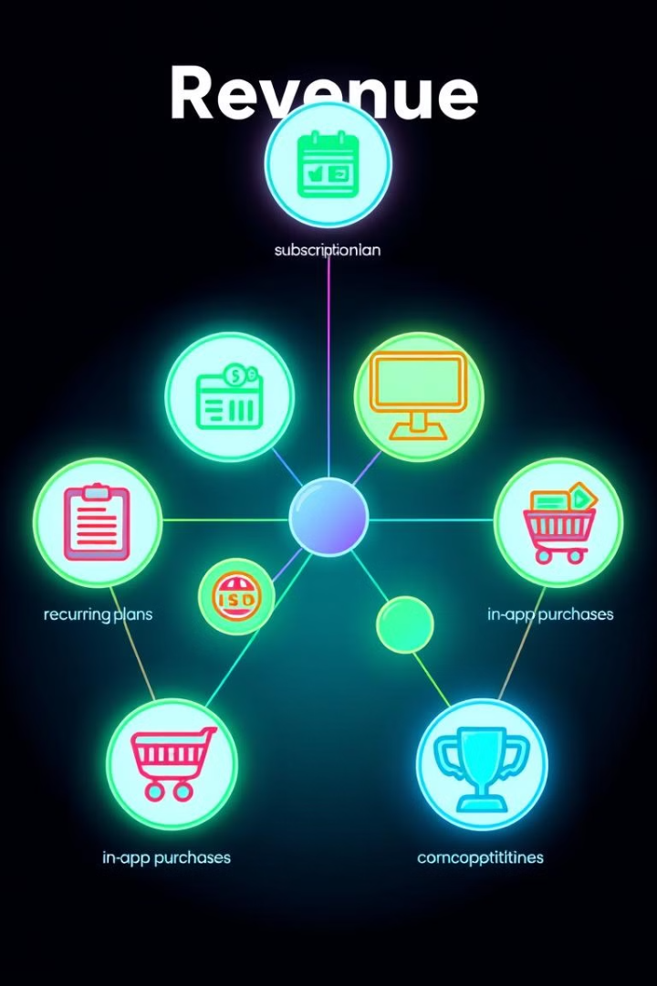
Revenue Model
1
Subscription Plans
2
In-App Advertisements
Monthly or yearly options.
Limited, education-focused ads.
3
In-App Purchases
4
Sponsored Competitions
Students can unlock features.
Corporate-sponsored challenges.

Slide 8
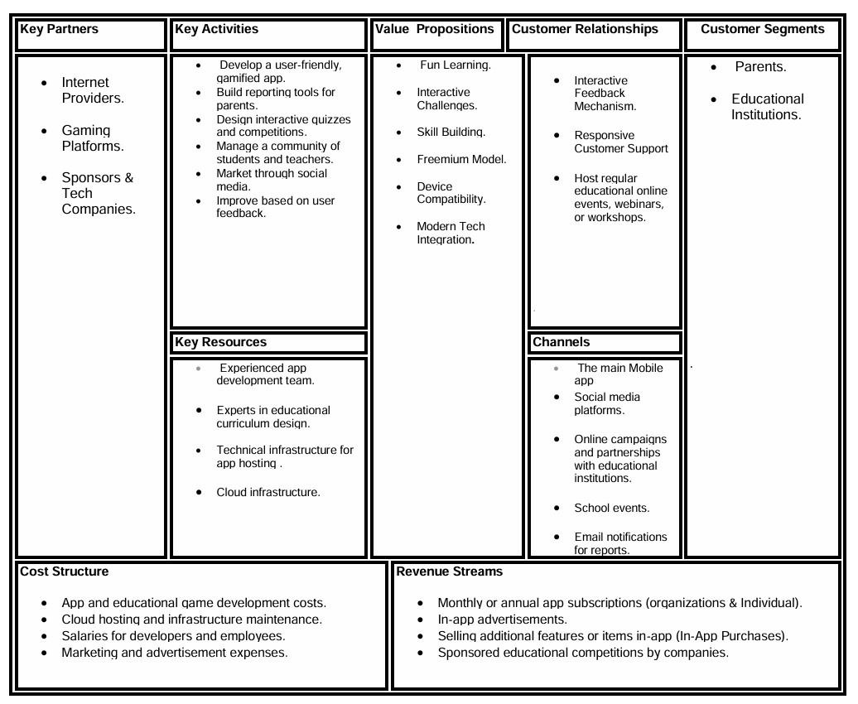

Slide 9

Thank you!
Together, let’s make learning fun!

